Slide 1
Financial Data Analysis of Insurance Sector
Course: Financial Data Science
Prof: Abdullah Karasan
Deekshitha Bhogathi

Slide 2
Objective and Scope:The project aimed to analyze the financial performance of five insurance companies, using the S&P 500 Index as a market benchmark, over five years from 2019 to 2024. The analysis spans pre-pandemic, pandemic, and post-pandemic market conditions.
Data Collection and Preparation:Stock price data for the insurance companies and the S&P 500 Index were collected, followed by data cleaning to ensure accuracy and completeness for analysis.
Exploratory Data Analysis (EDA):EDA techniques, including time series plots of stock prices, were used to visualize performance trends over the specified period.
Statistical Analysis for In-depth Insights:Statistical measures like mean, standard deviation, Z-score, and confidence intervals were determined.
Main Financial Concepts:Financial concepts such as return, risk, covariance, correlation, and risk-return ratios were evaluated.
Capital Asset Pricing Model (CAPM) Analysis:Used CAPM to evaluate expected returns based on systematic risk, gaining insights into each company's market performance relative to overall market movements. Performance metrics calculators such as Sharpe and Treynor ratios were calculated.
Application of Modern Portfolio Theory (MPT):MPT principles guided the exploration of optimal investment strategies and portfolio construction, enhancing investment decision-making.
Time Series Analysis:The time series analysis focused on evaluating and forecasting insurance stock prices using methods like decomposition, stationarity testing, ARIMA, and Monte Carlo simulations to understand patterns and predict future trends
Introduction

Slide 3
Motivation:
Resilience and Strategic Insights: To evaluate the financial performance and resilience of key insurance companies (AIG, MET, PRU, ALL, and TRV) by analyzing their stock price behavior and financial metrics over a five-year period (2019-2024), including pre-pandemic, pandemic, and post-pandemic phases.
Understanding Market Risk and Returns: To investigate how these companies navigate market dynamics using risk-return metrics such as Sharpe Ratios, Treynor Ratios, and Z-scores, highlighting differences in risk exposure and return potential.
Application of Financial Models: To integrate advanced financial models like CAPM, ARIMA, Monte Carlo Simulations, and Modern Portfolio Theory to evaluate systematic risk, forecast future performance, and construct optimal investment portfolios.
Enhancing Investment Decision-Making: To provide actionable insights for portfolio allocation and risk management, offering lessons on strategic adaptability in volatile market conditions and enhancing informed decision-making.
Contribution to Financial Understanding: To bridge the gap between academic financial concepts and their practical application, helping stakeholders understand how these companies adapt to global economic disruptions.

Slide 4
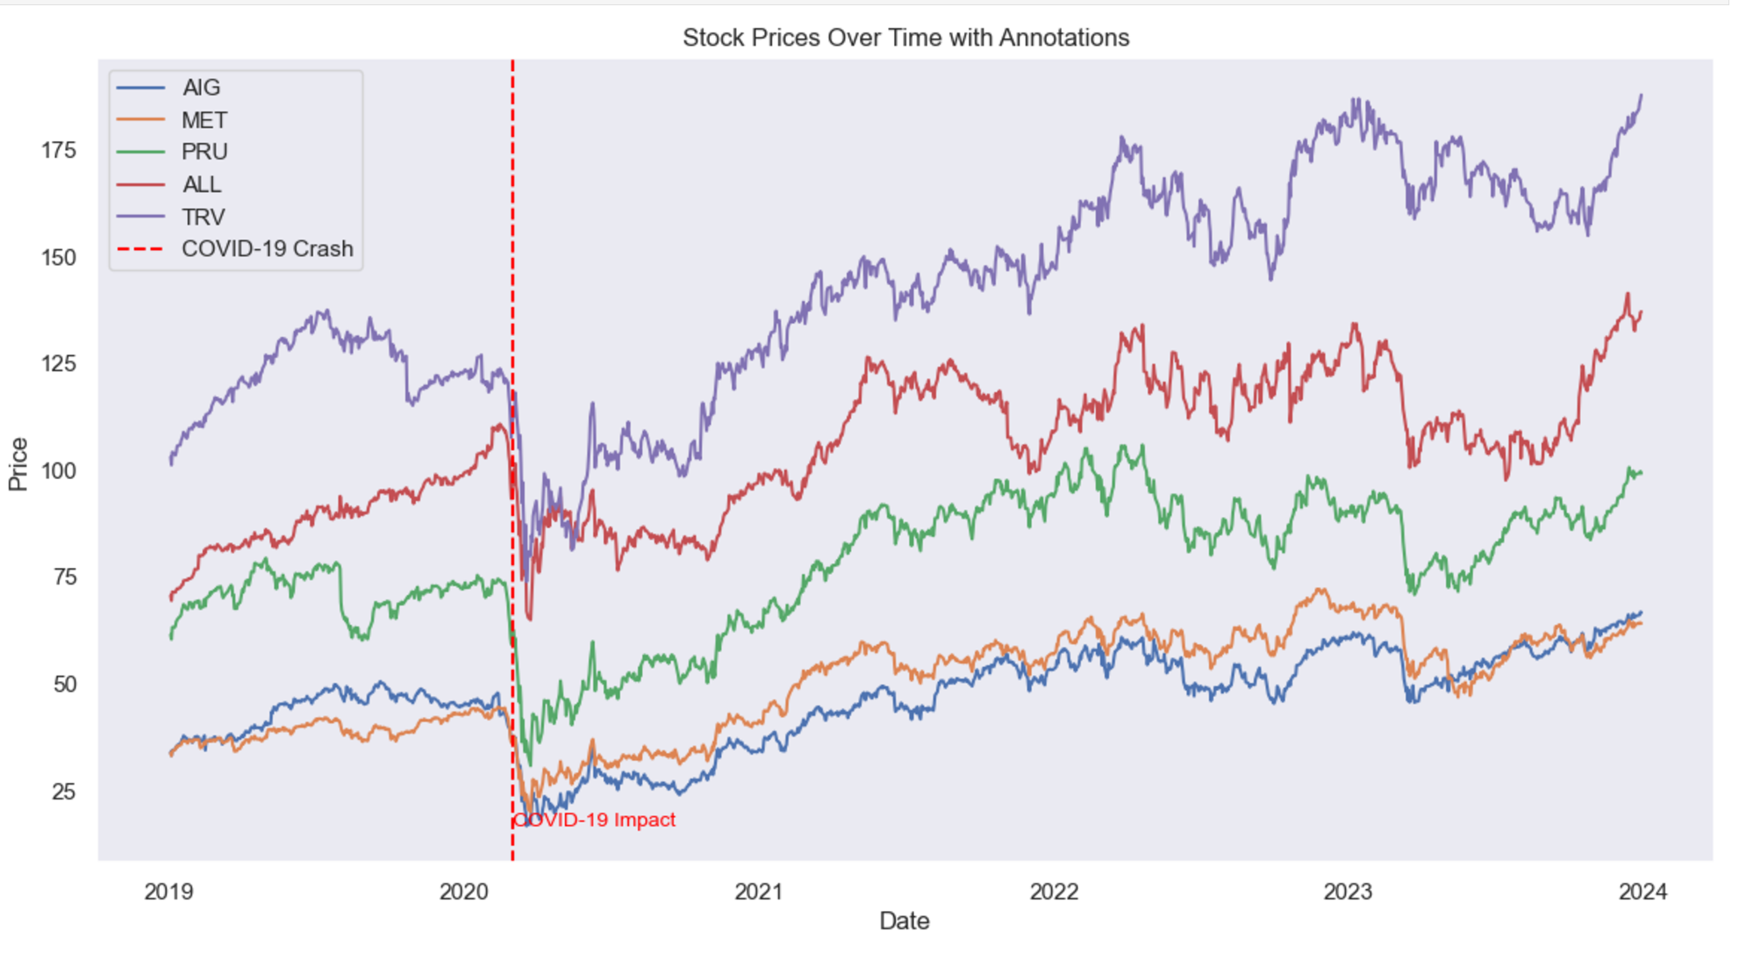
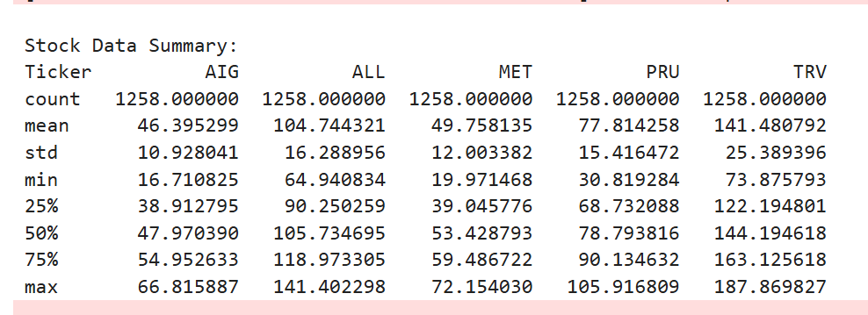
Stock Analysis

Slide 5
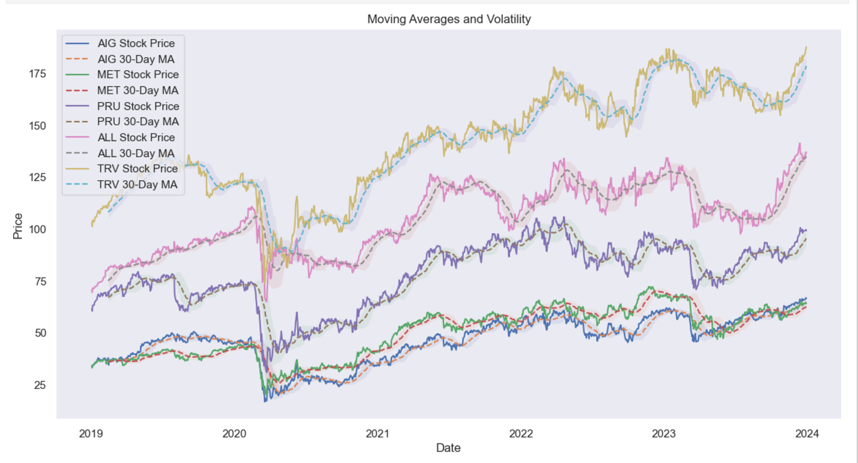
Moving Averages and Volatility:

Slide 6
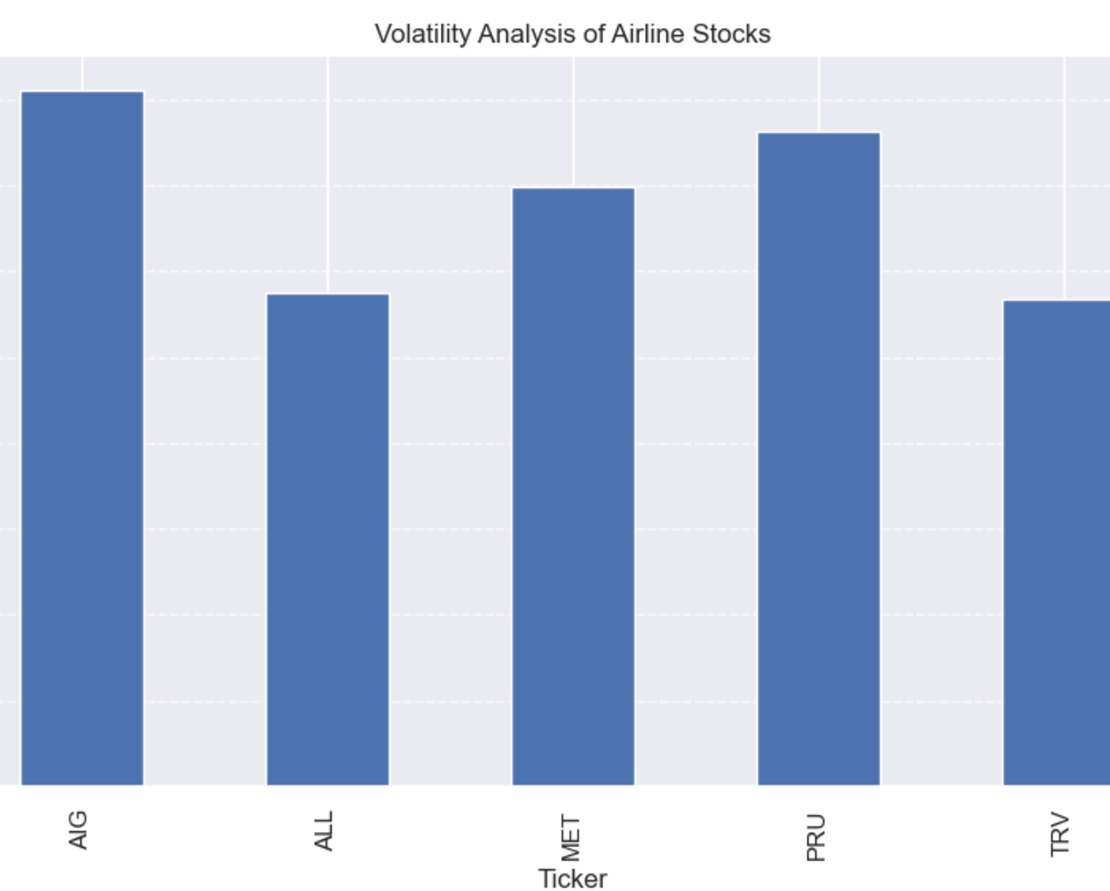
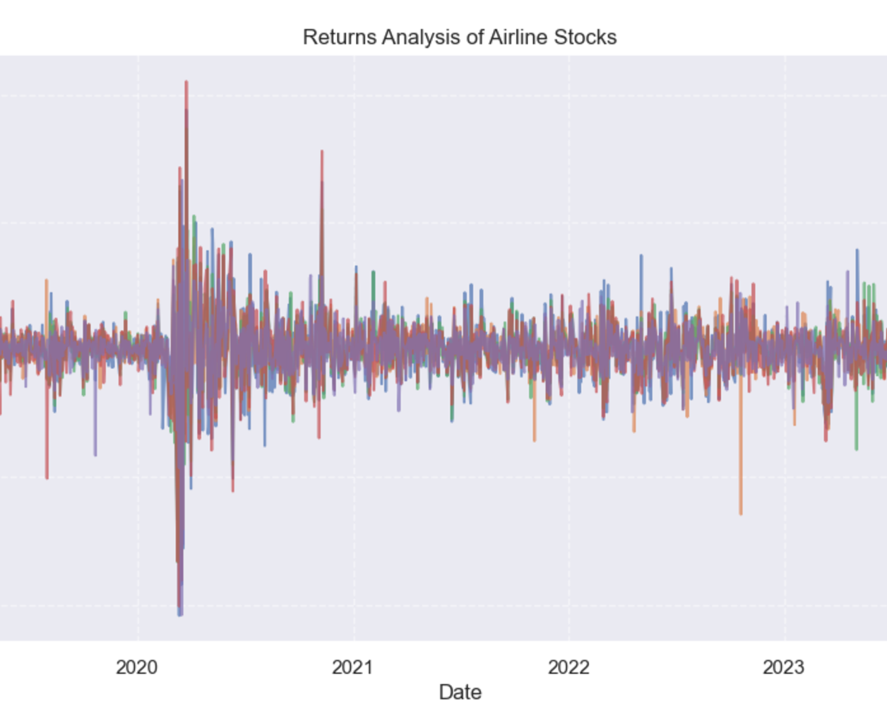
Volatility and Returns:

Slide 7
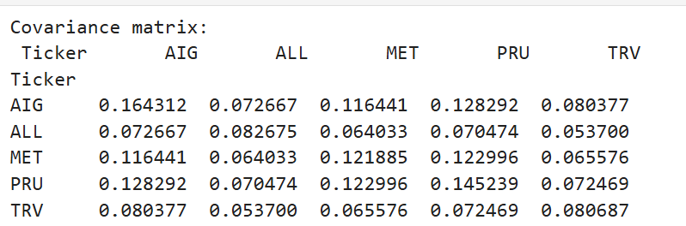
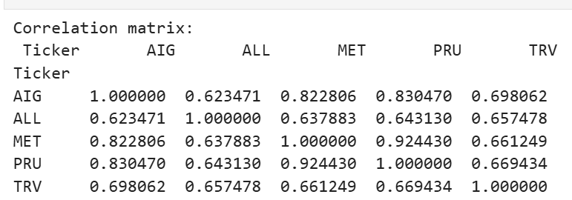
Correlation and Covariance Matrix

Slide 8
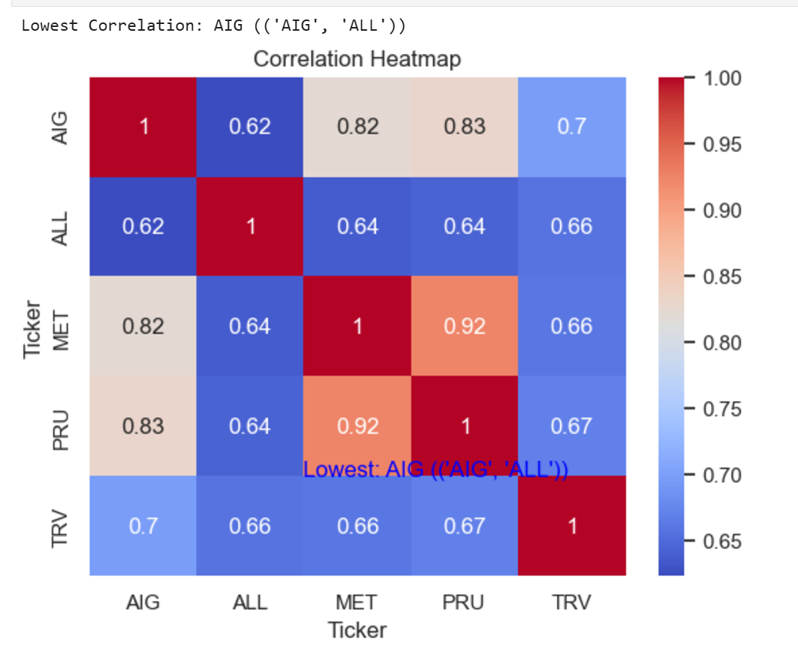
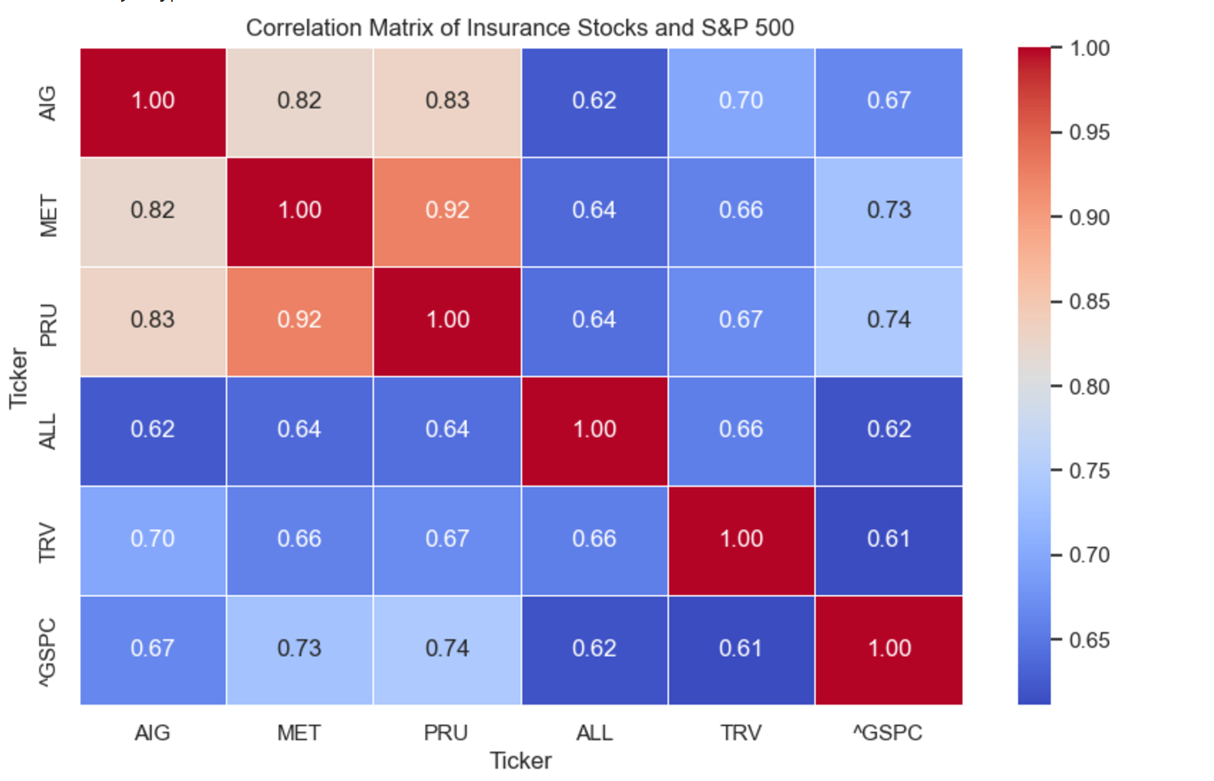
Correlation Matrix:

Slide 9
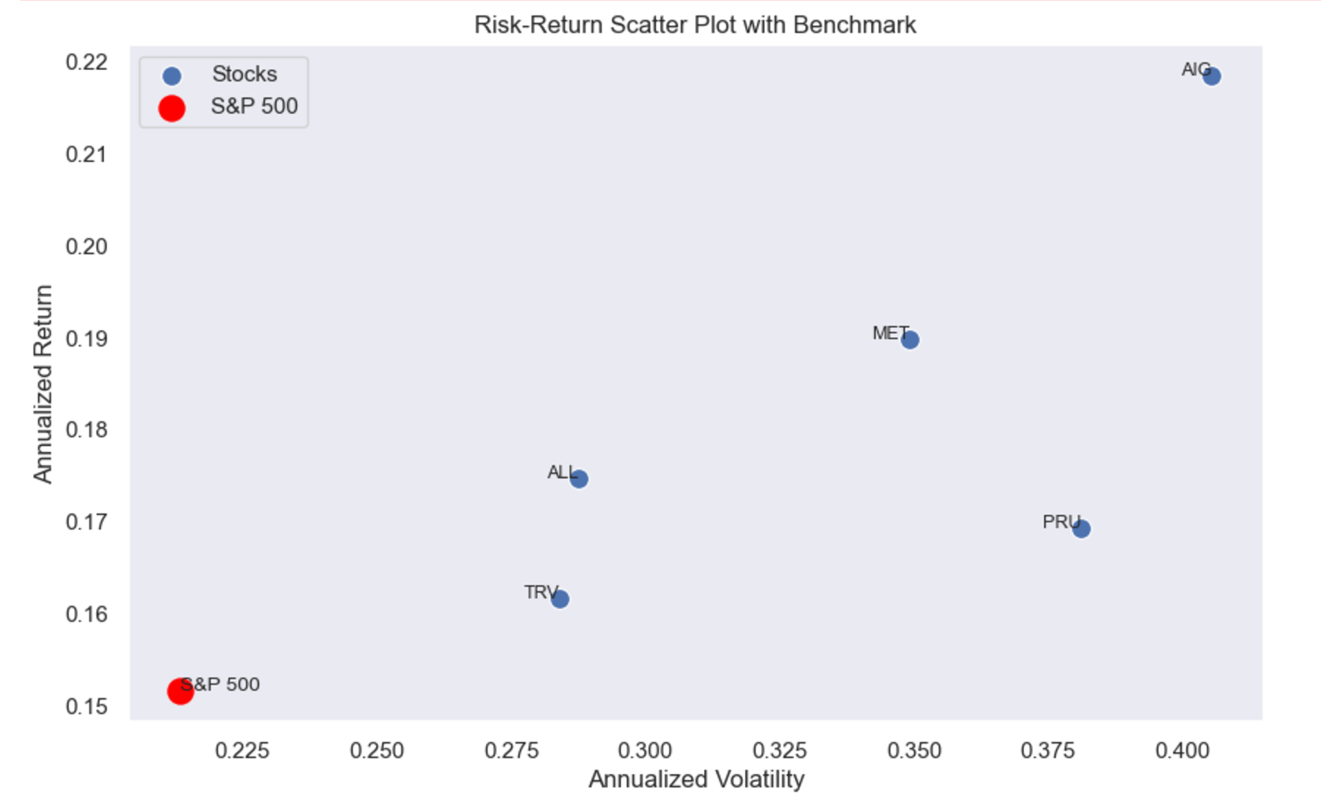
Risk-Return Plot:

Slide 10
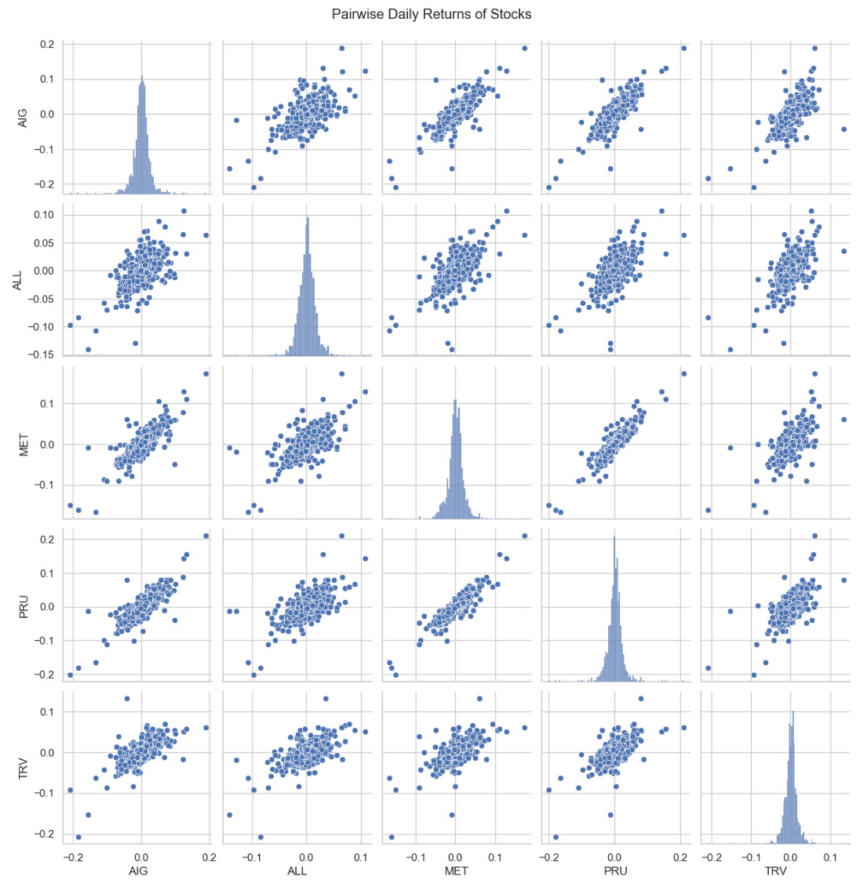
Pair Wise Analysis:

Slide 11
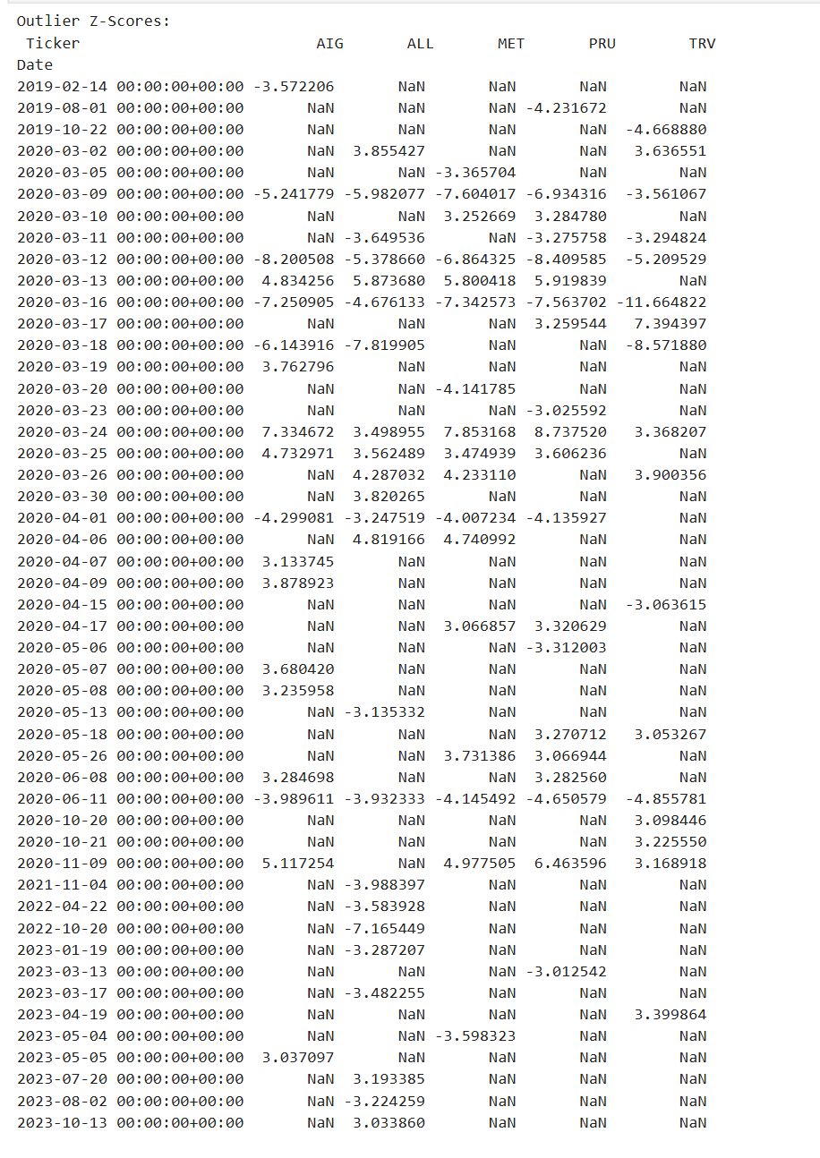
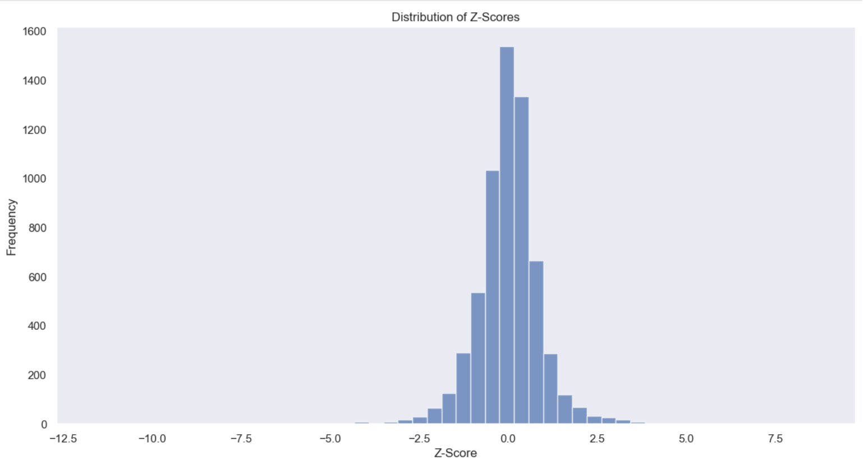
Z-Scores:

Slide 12
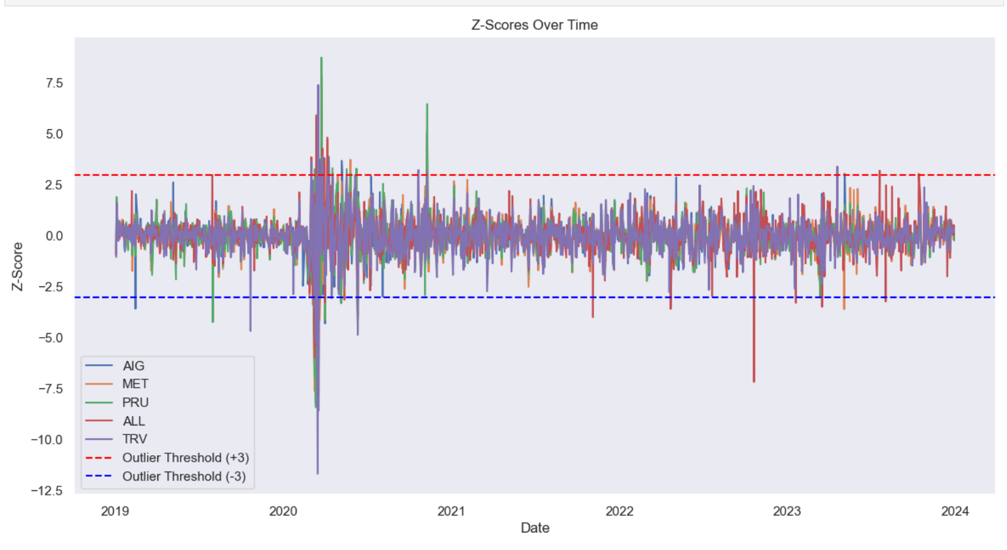
Z-Scores:

Slide 13
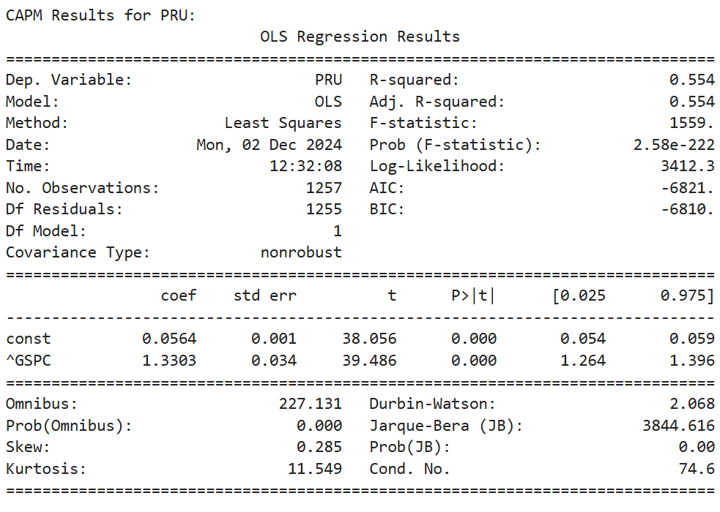
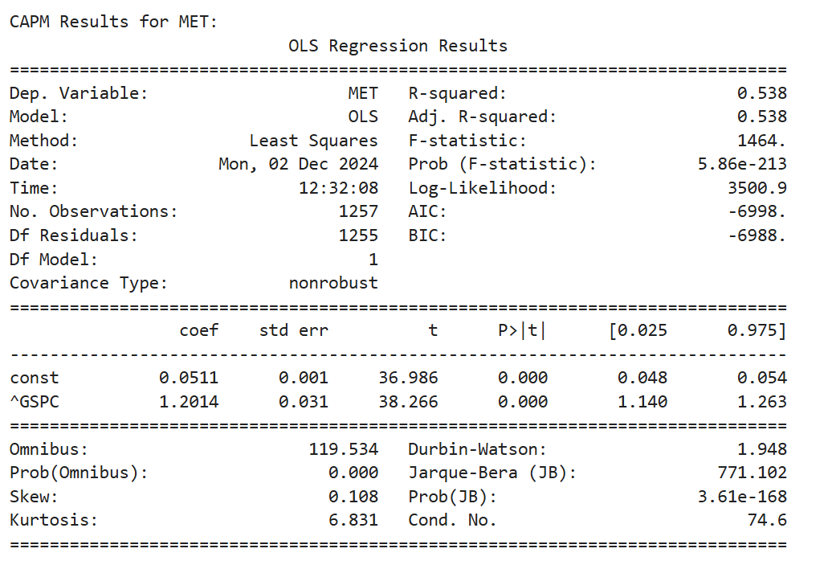
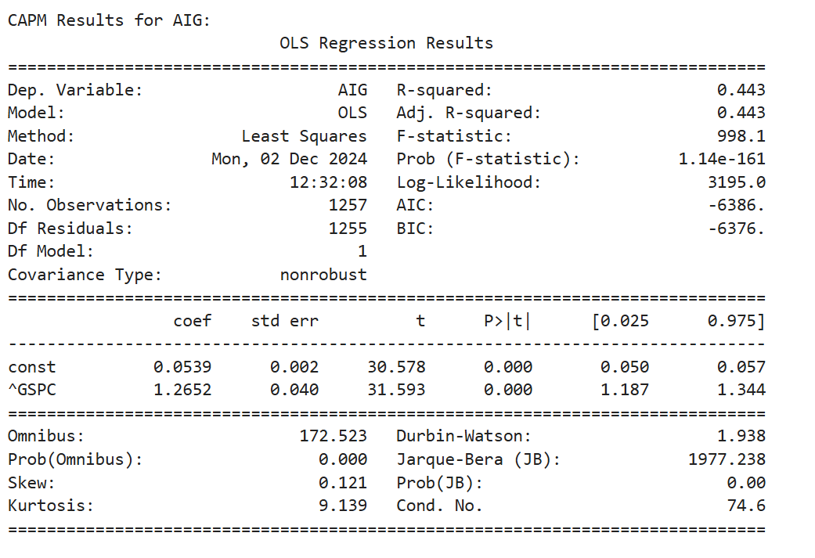
CAPM Analysis:

Slide 14
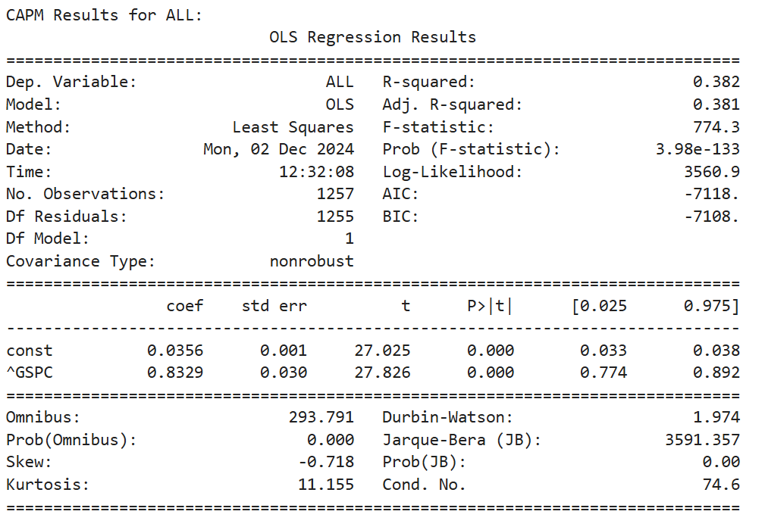
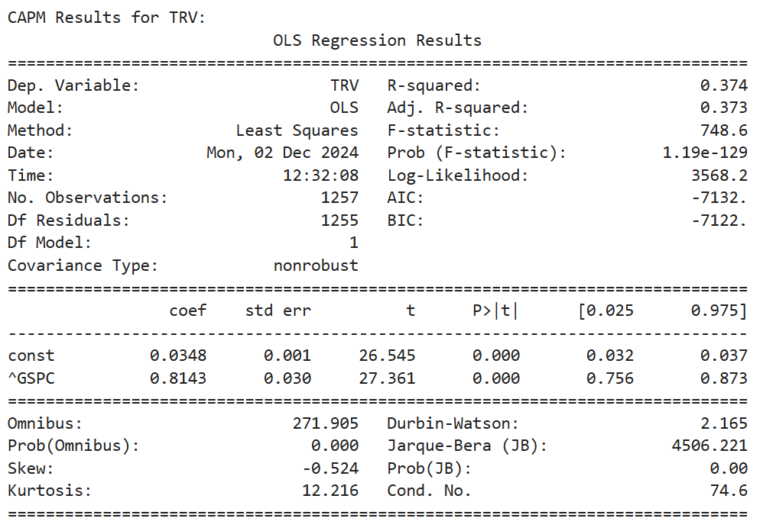
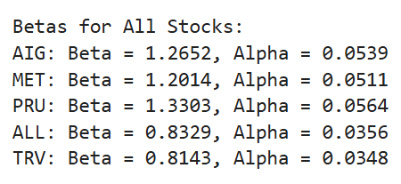
CAPM Analysis:

Slide 15
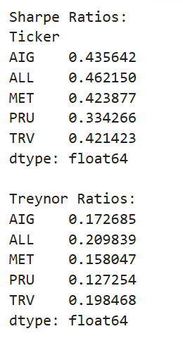
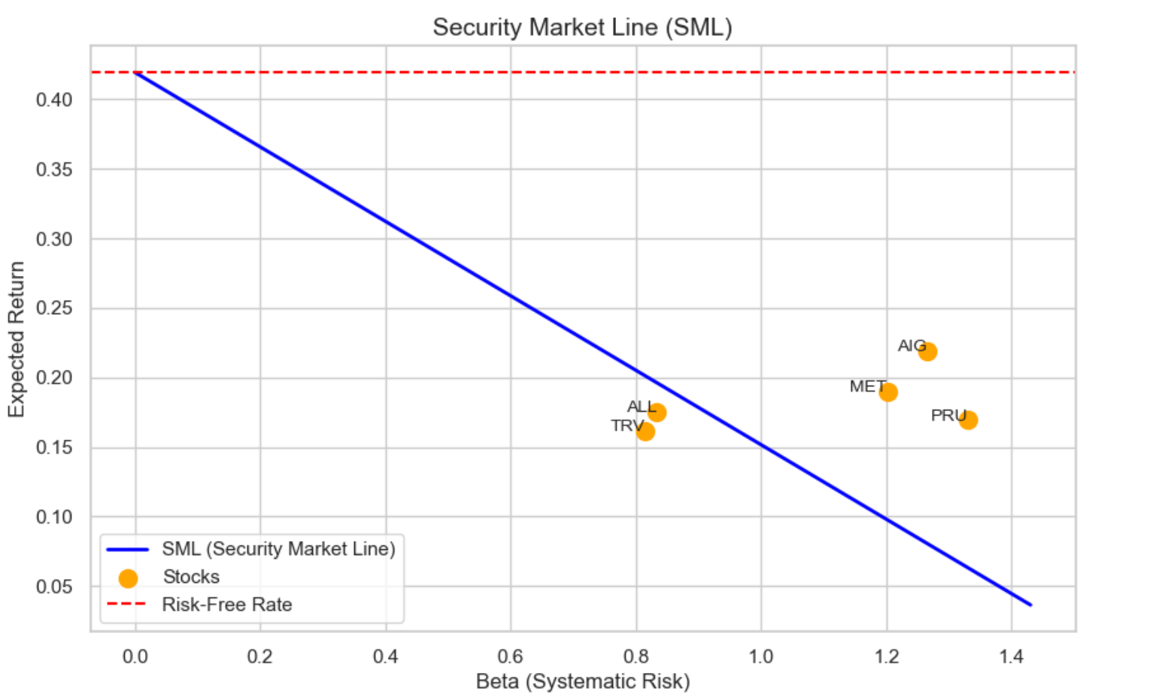
Security Market Line:

Slide 16
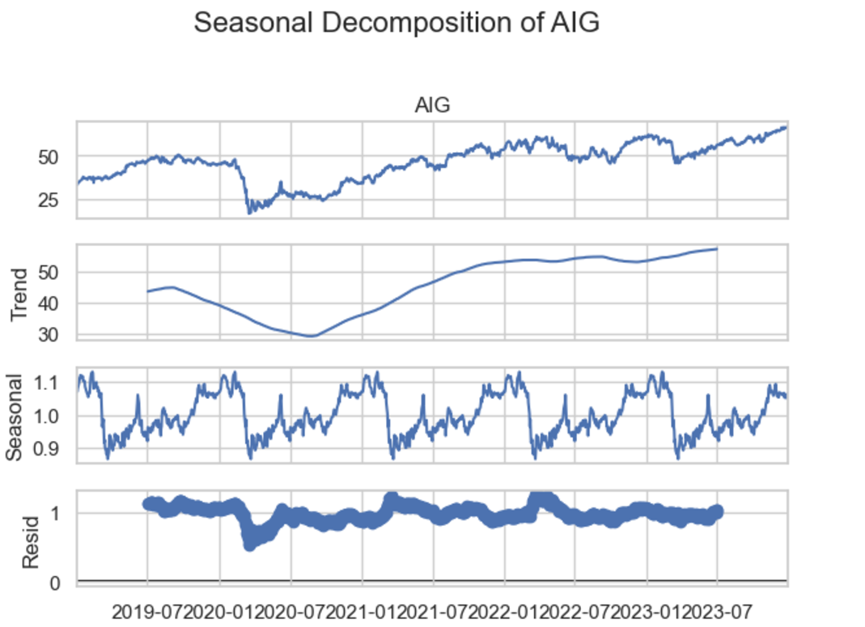
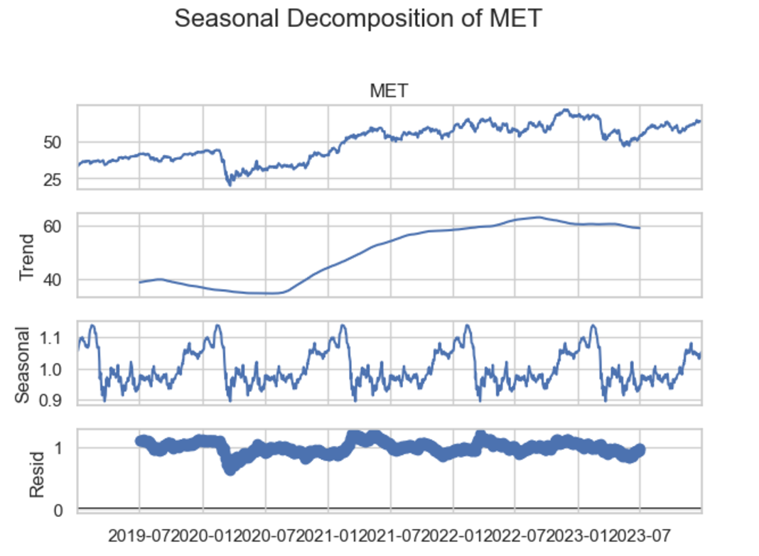
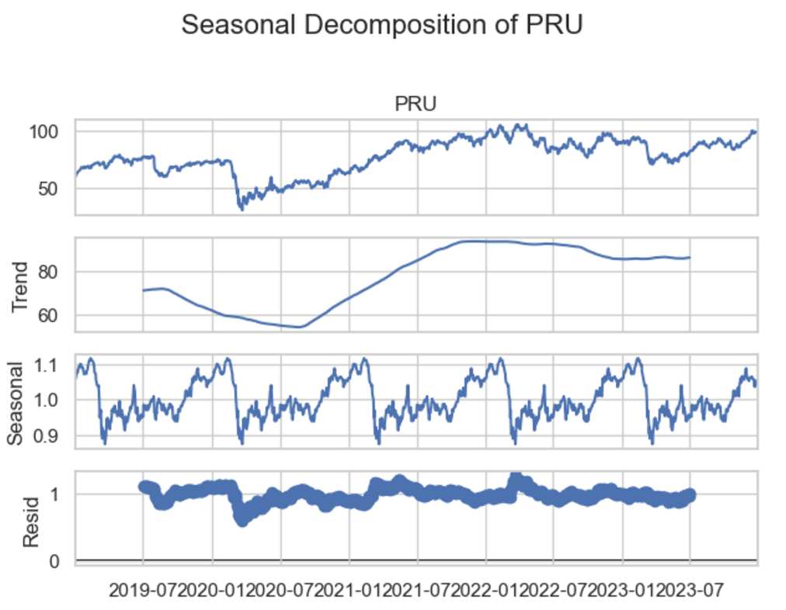
Decomposition:

Slide 17
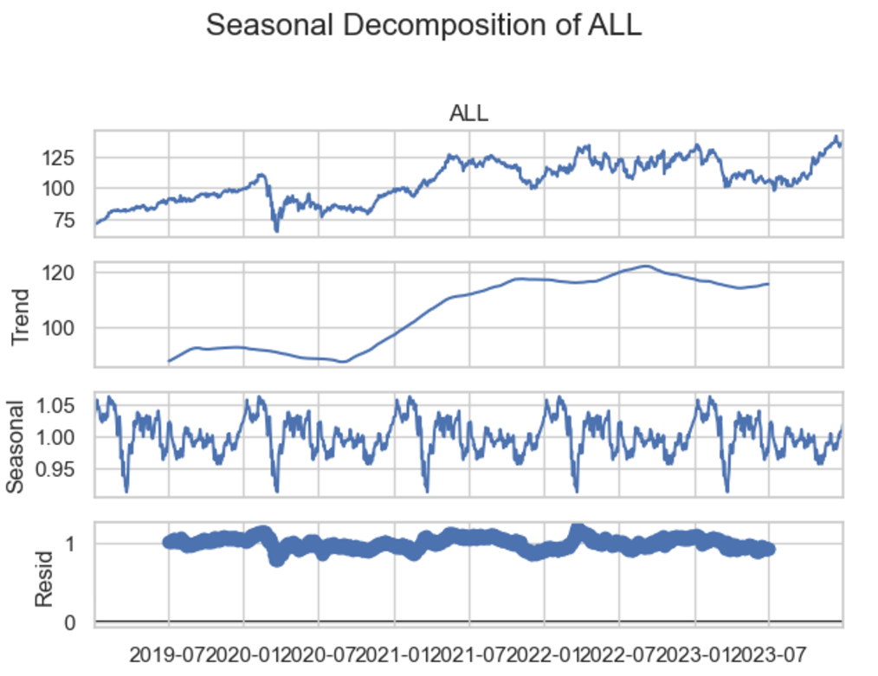
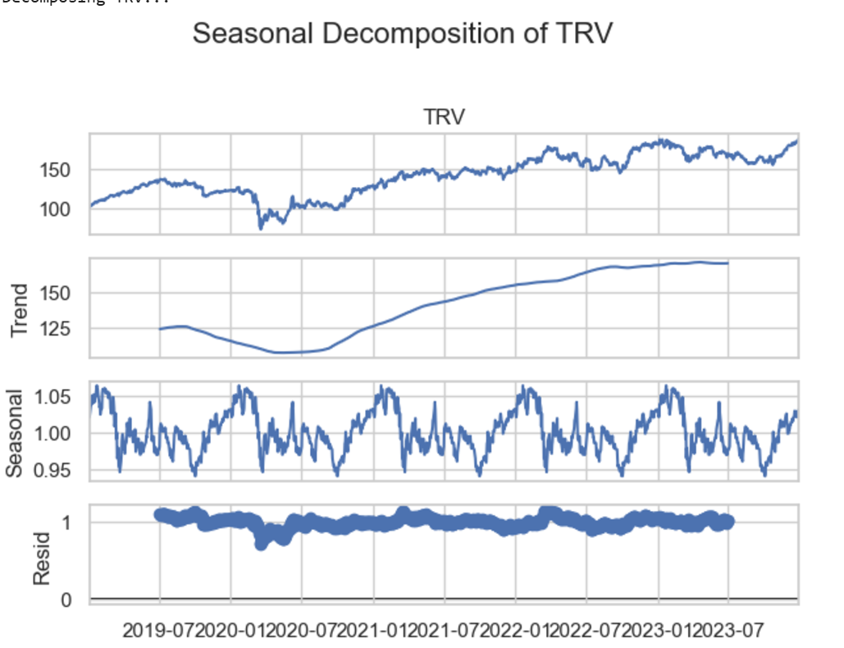
Decomposition:

Slide 18
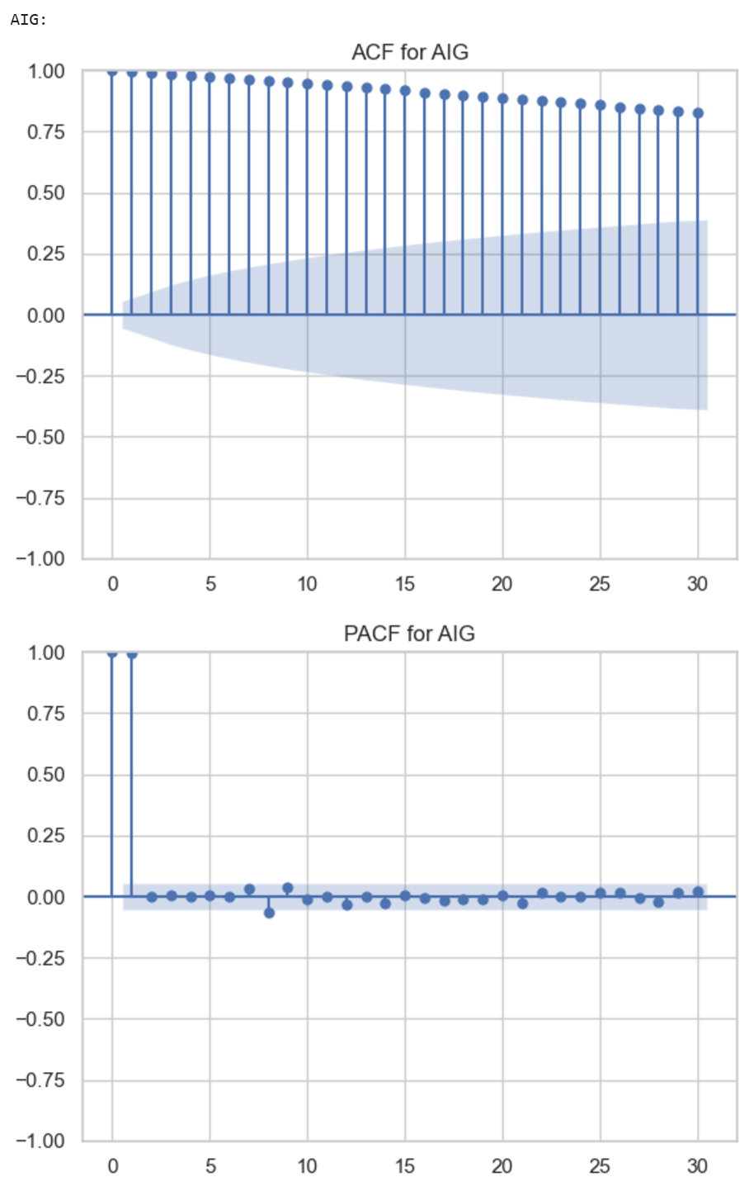
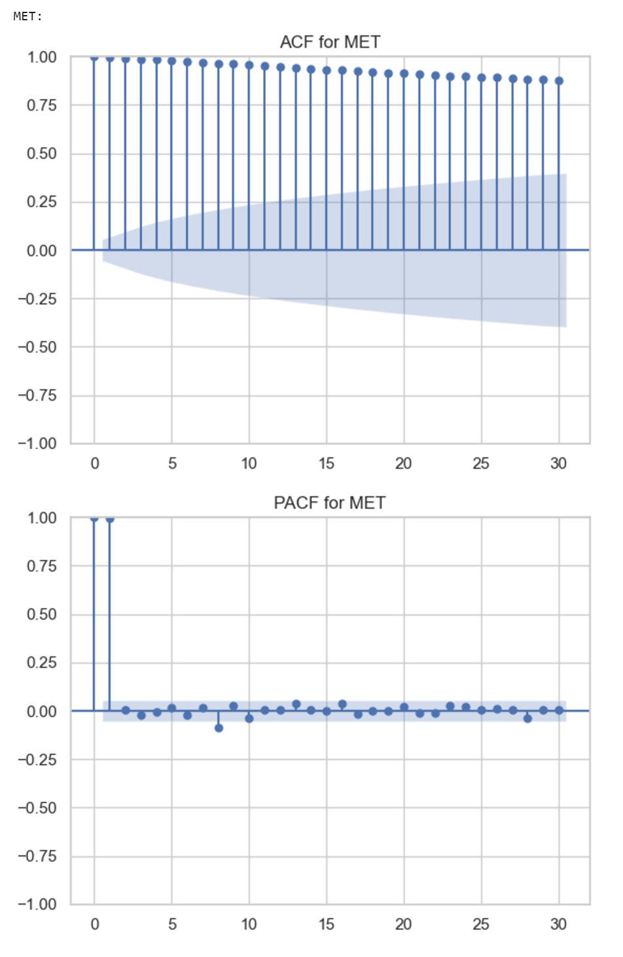
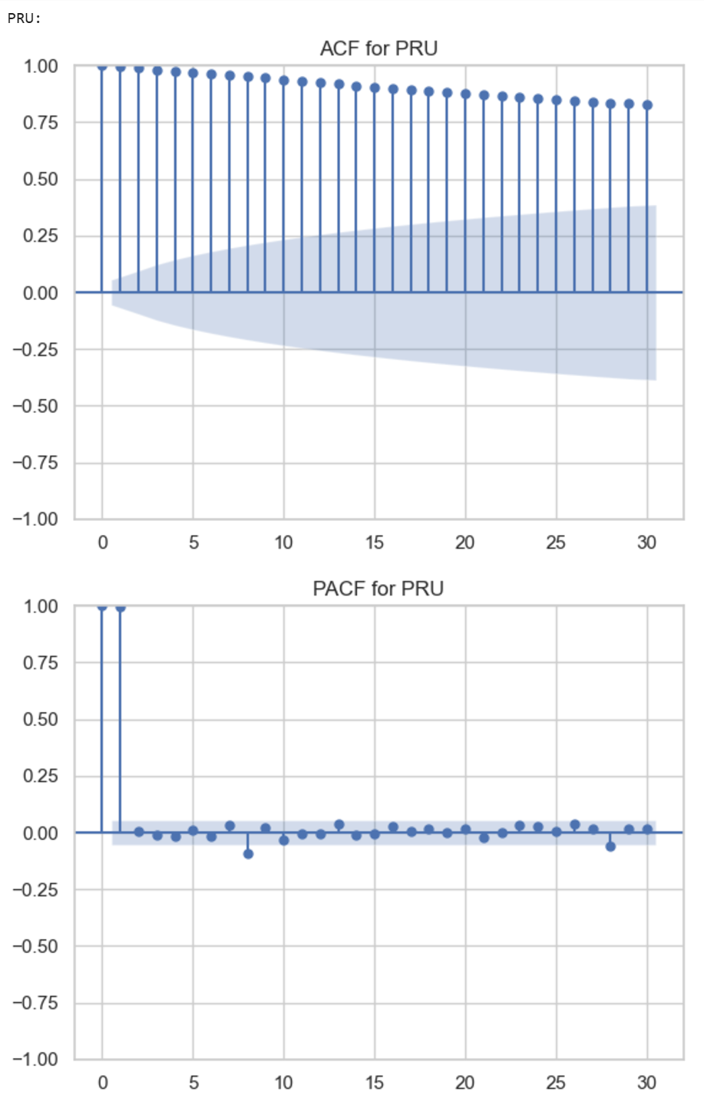
ACF and PACF:

Slide 19
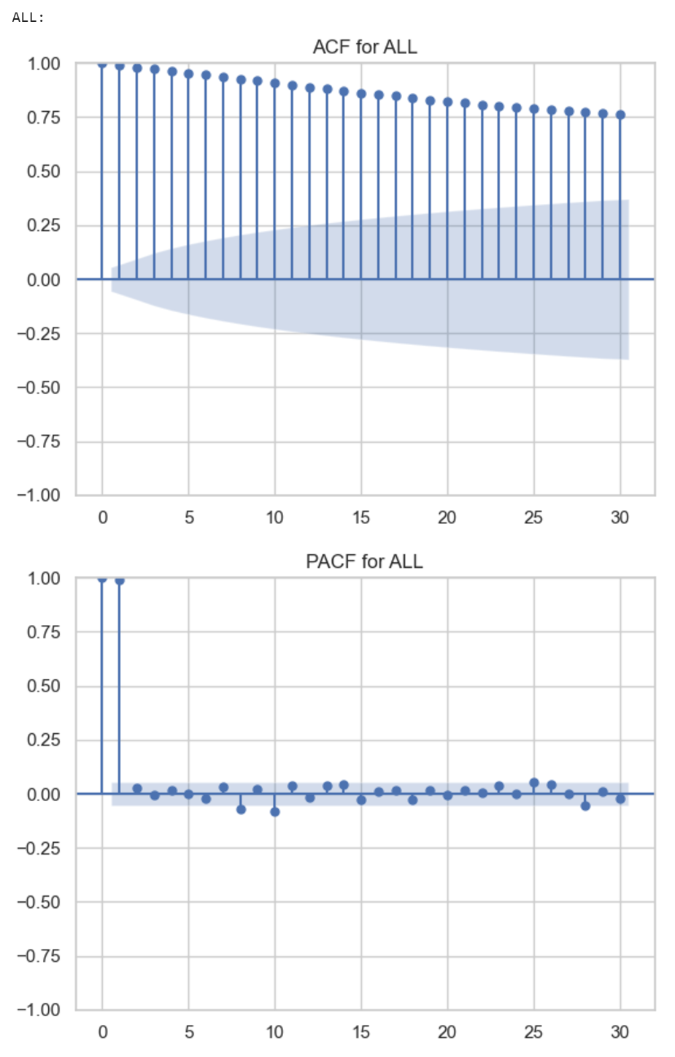
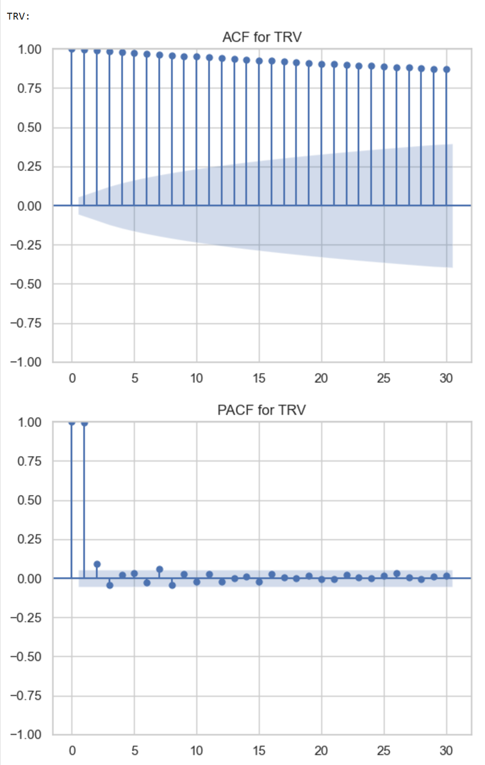
ACF and PACF:

Slide 20
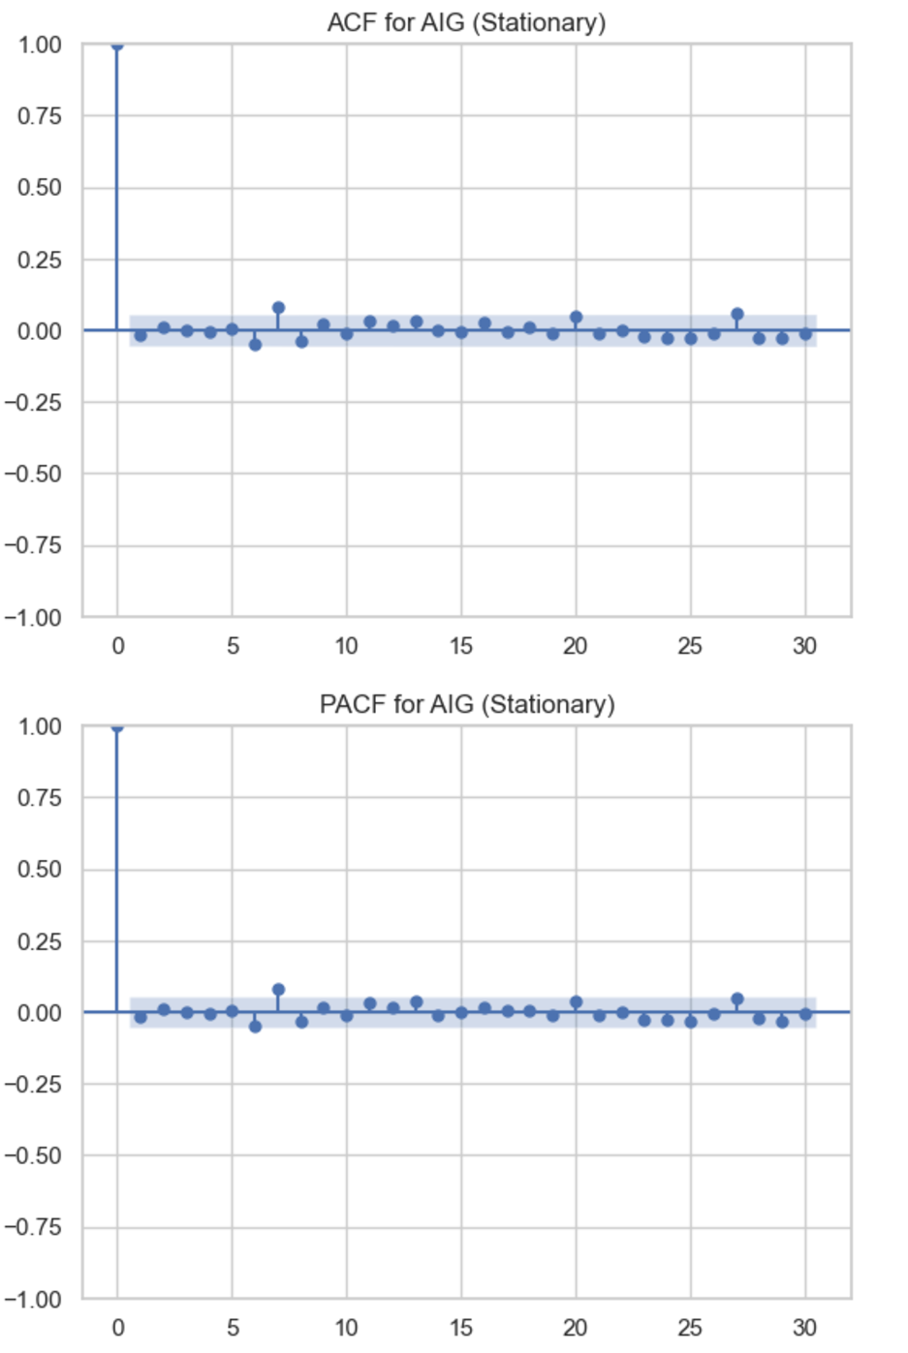
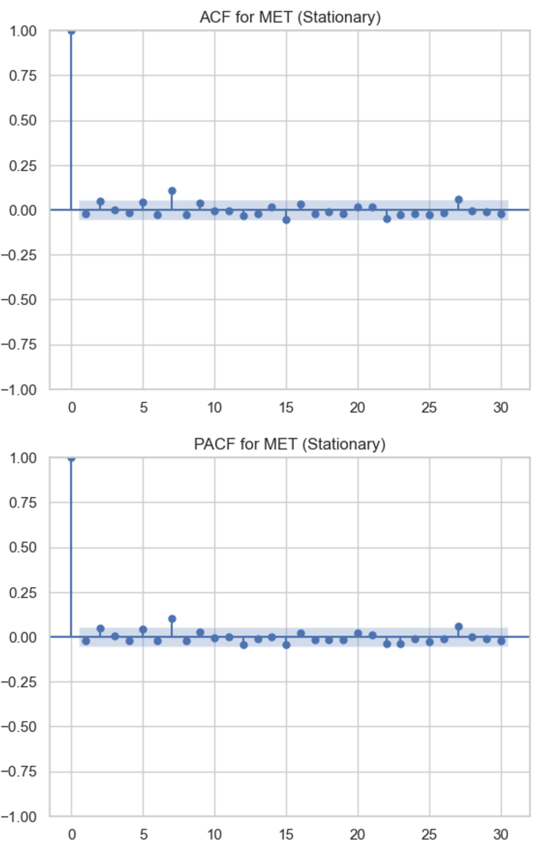
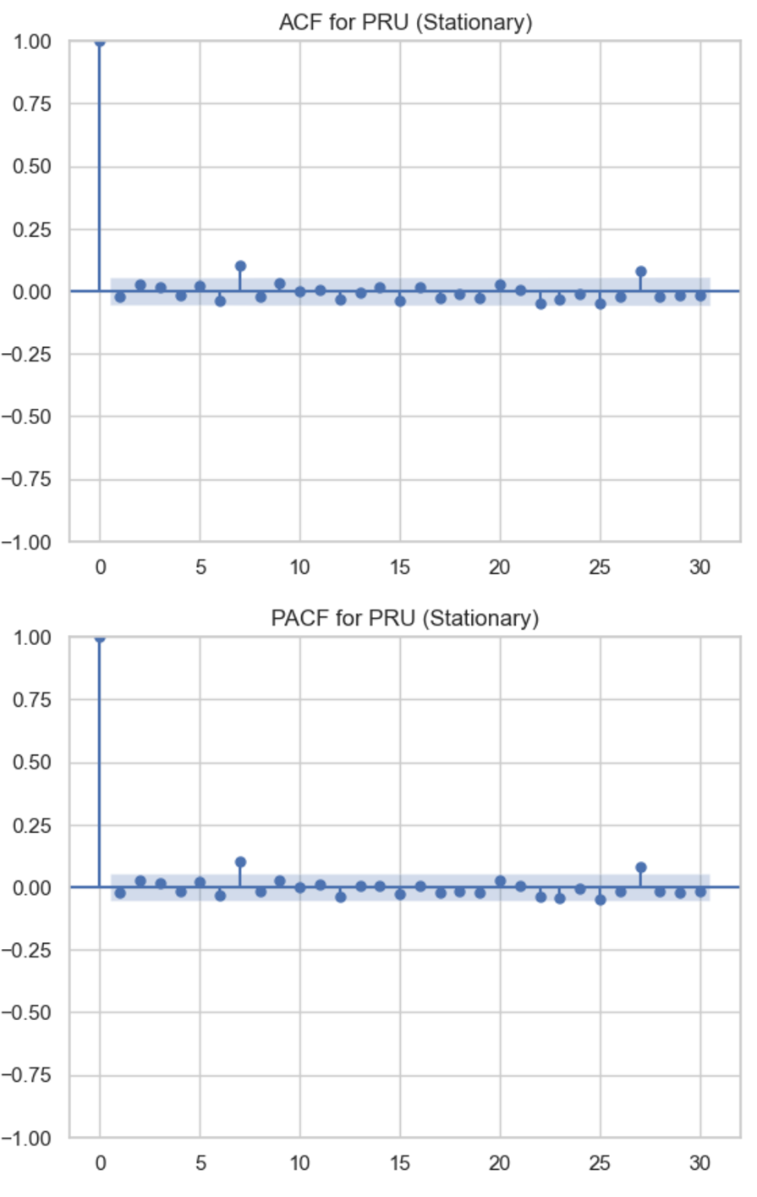
ACF and PACF:

Slide 21
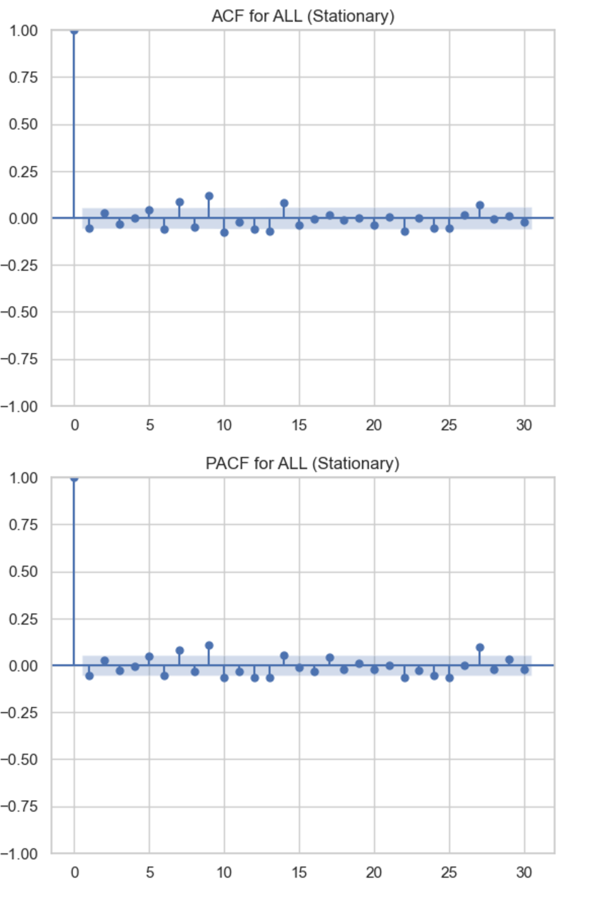
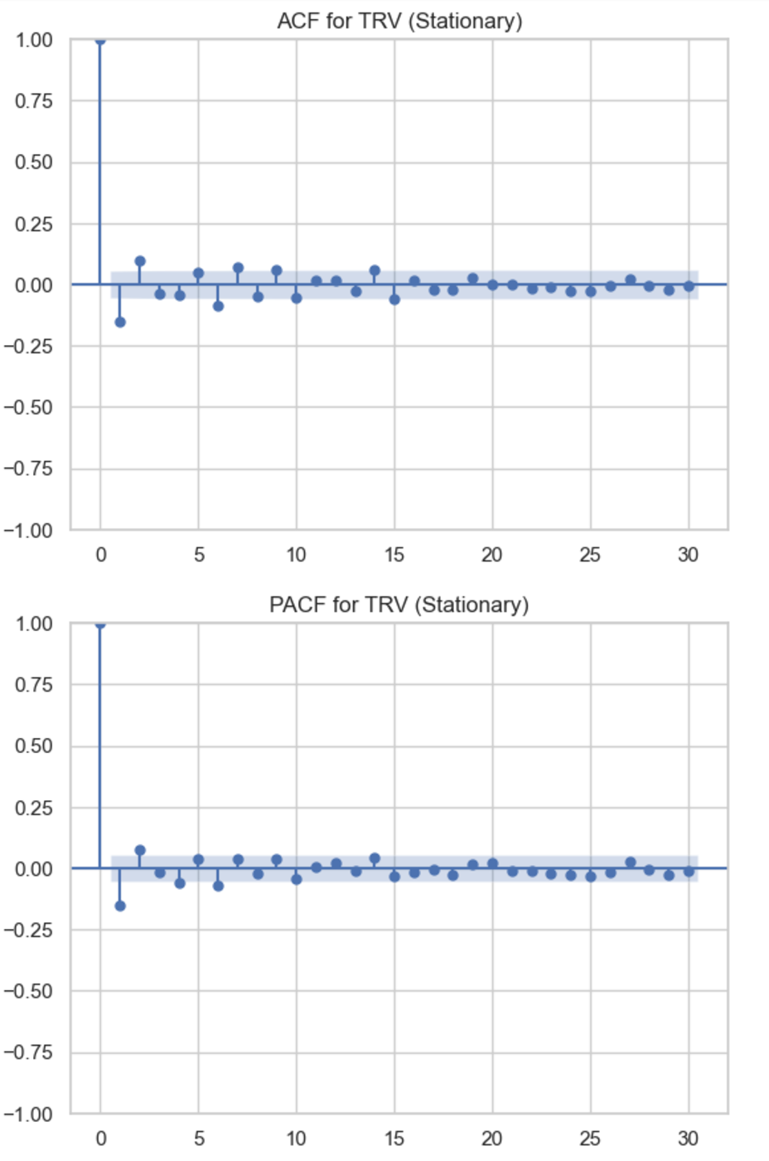
ACF and PACF:

Slide 22
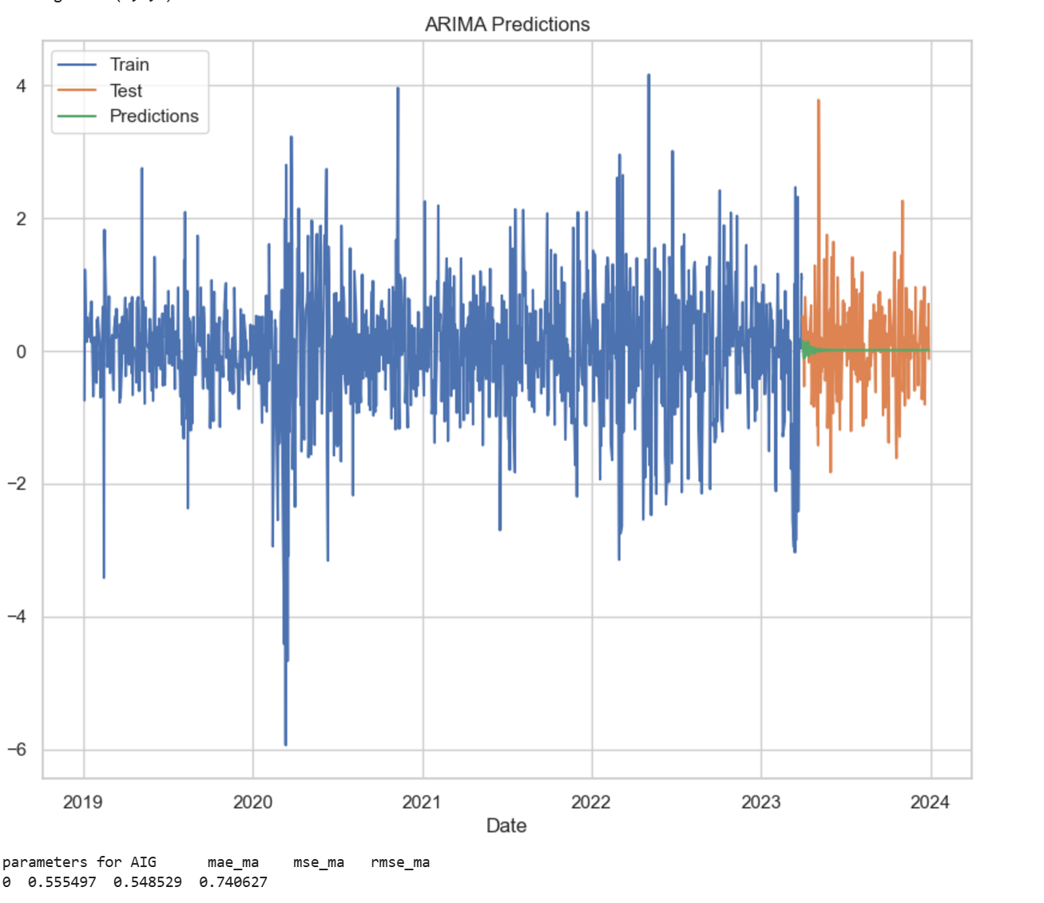
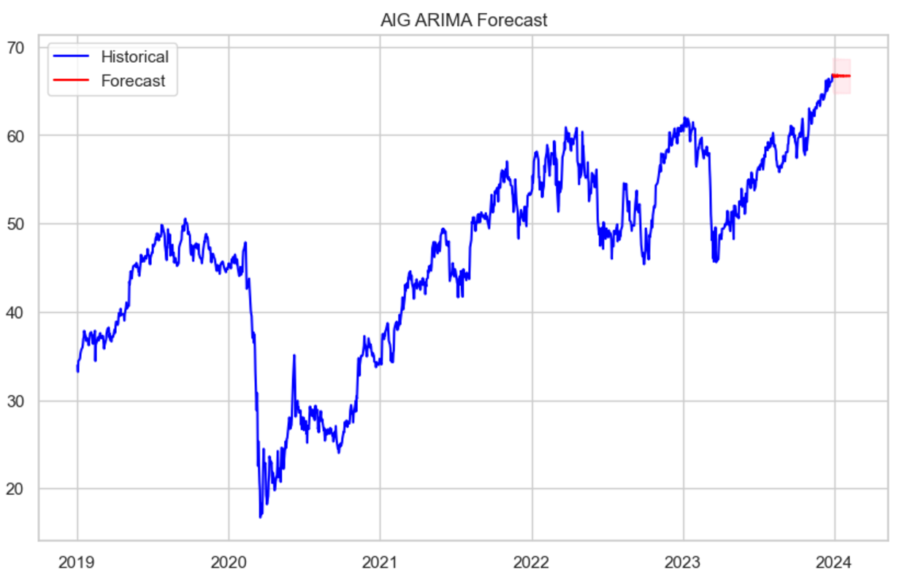
ARIMA Forecast:

Slide 23
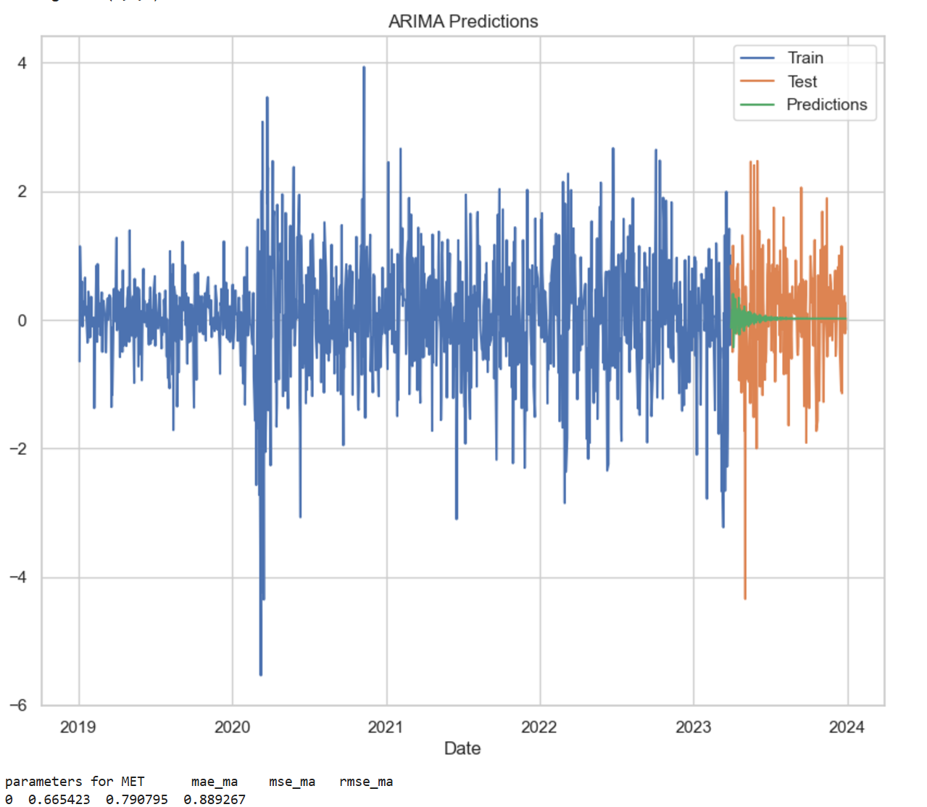
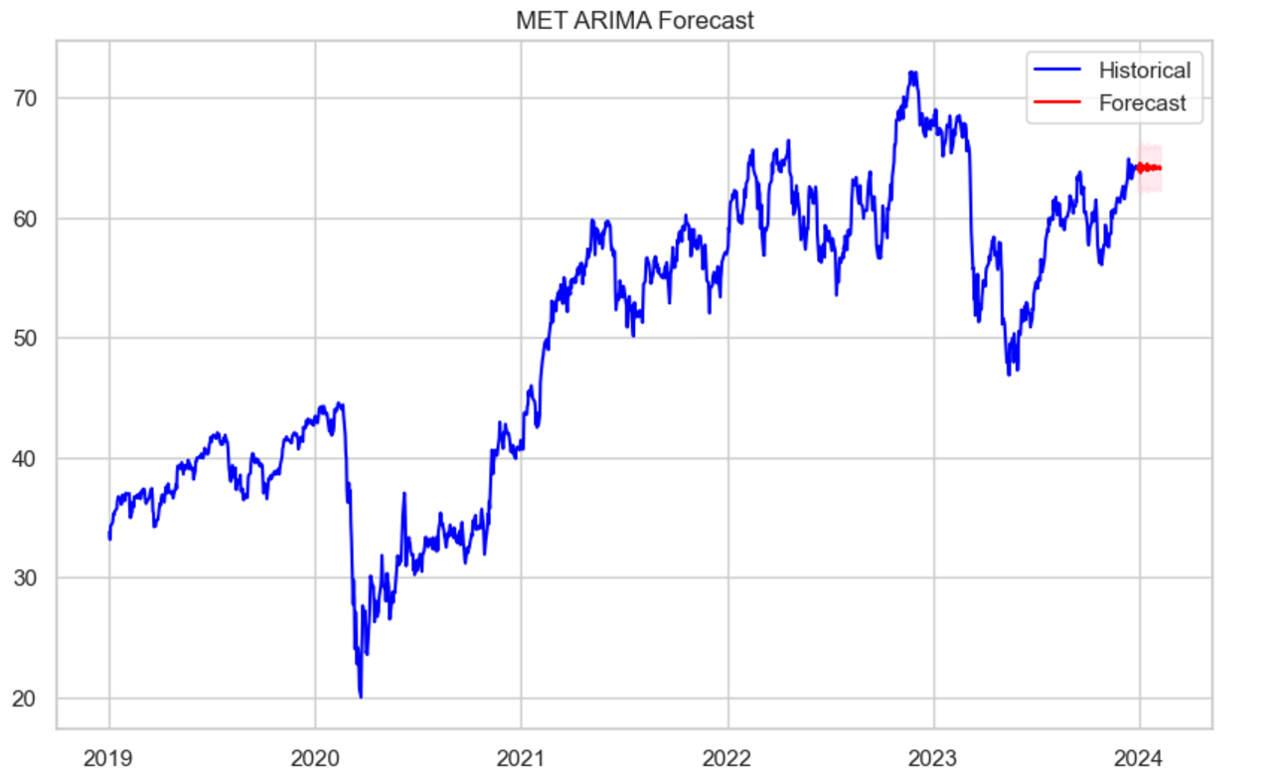
ARIMA Forecast:

Slide 24
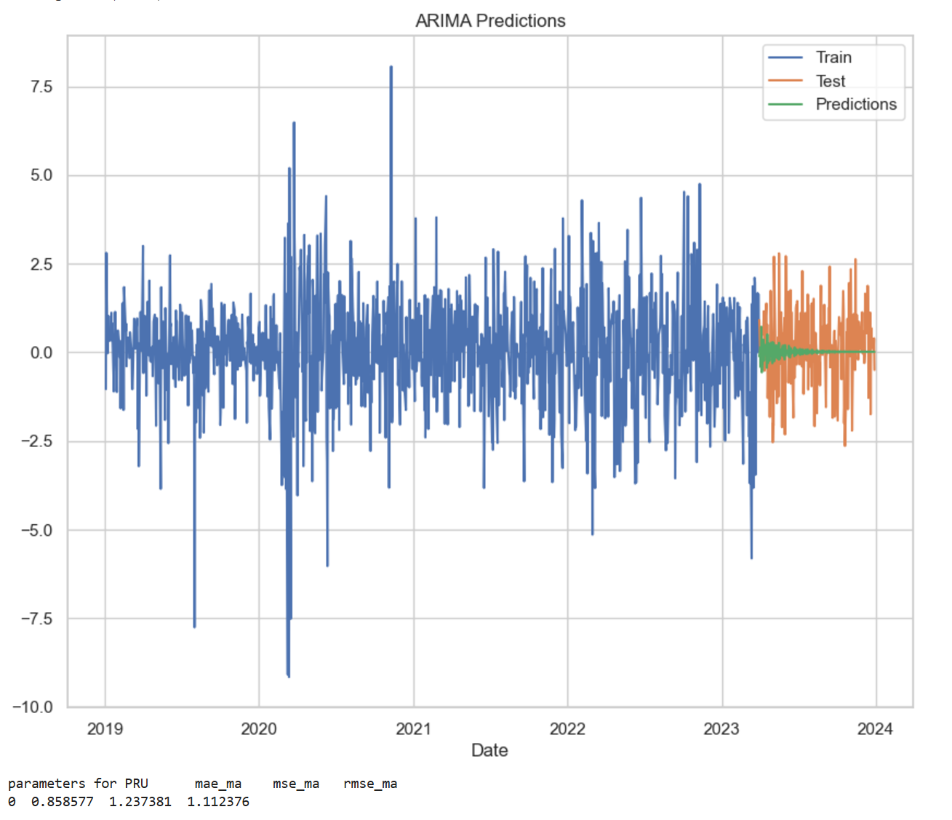
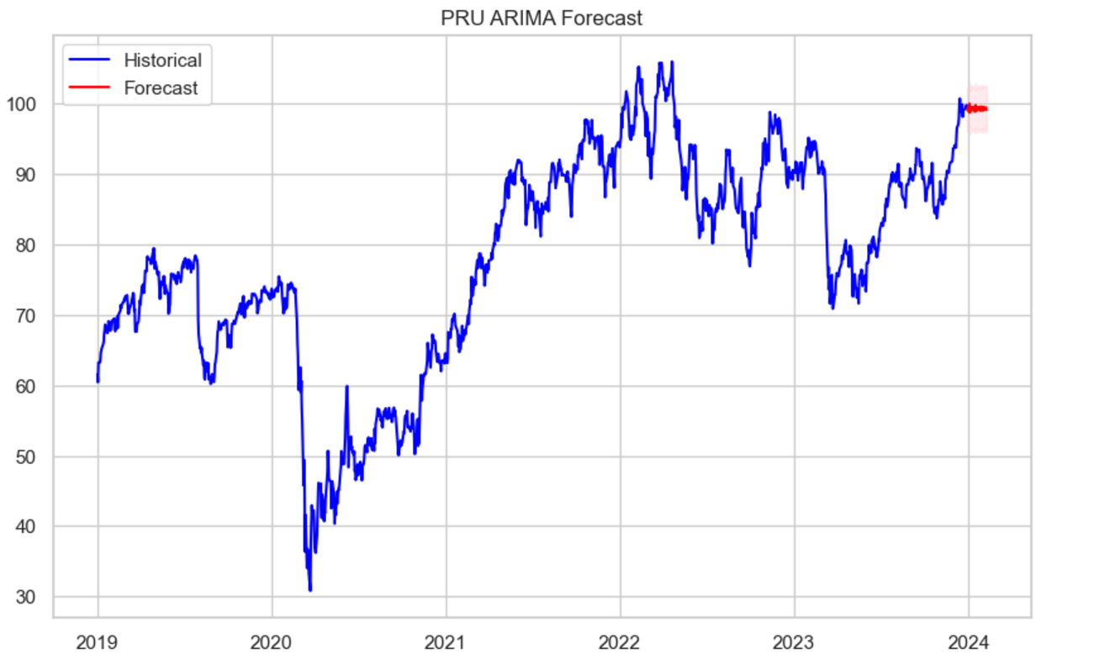
ARIMA Forecast:

Slide 25
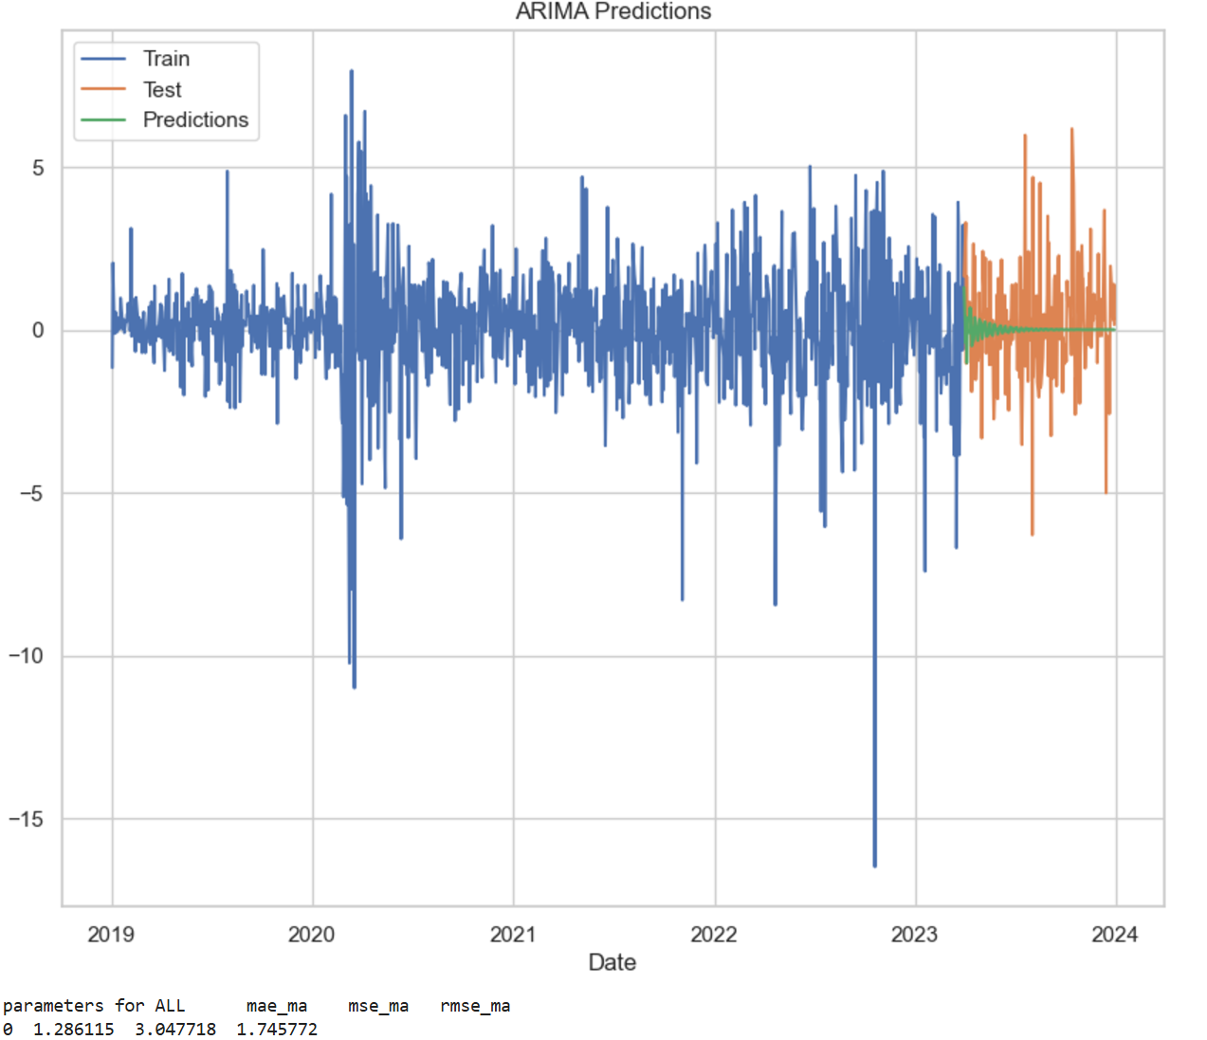
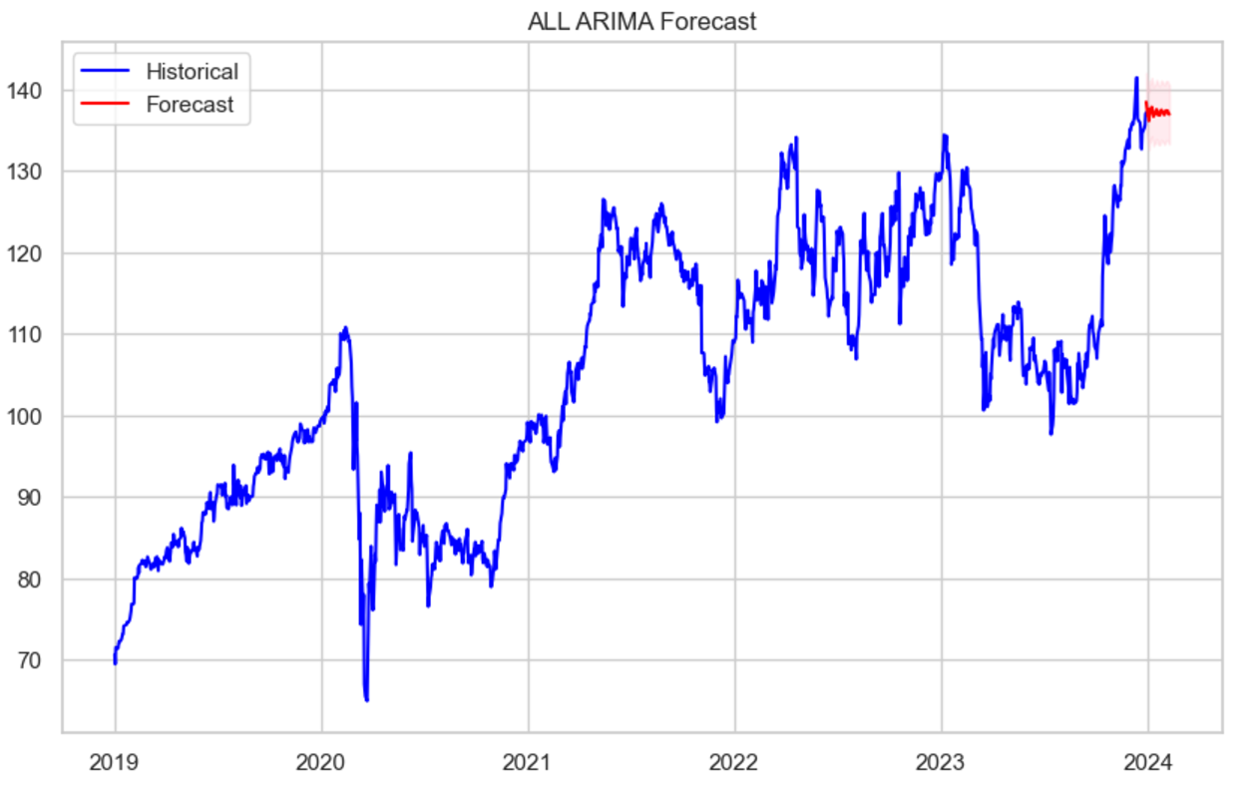
ARIMA Forecast:

Slide 26
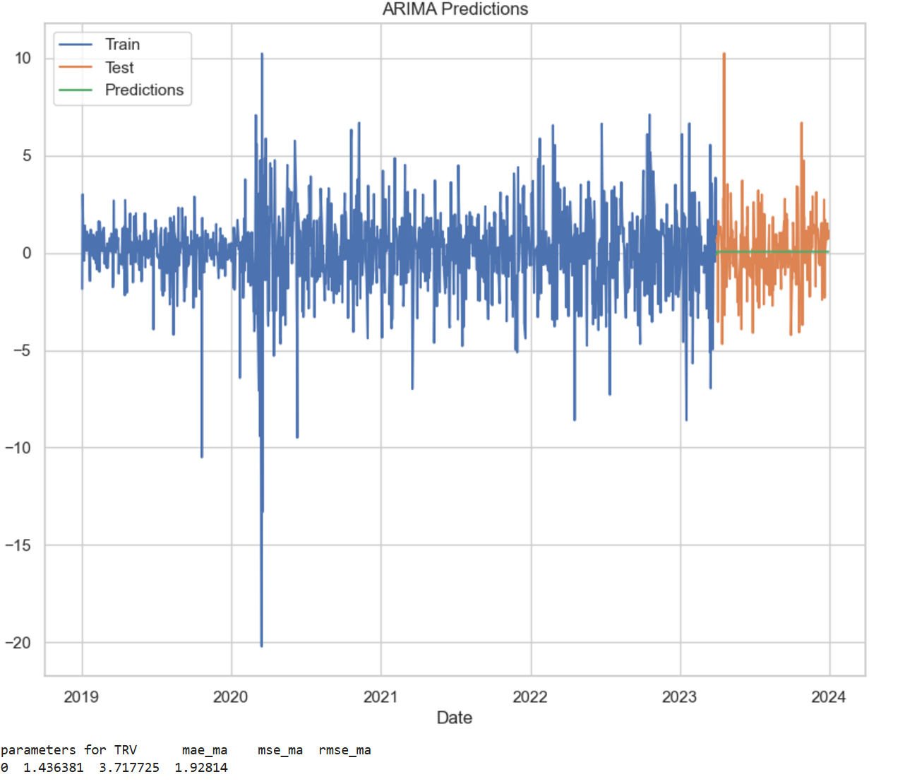
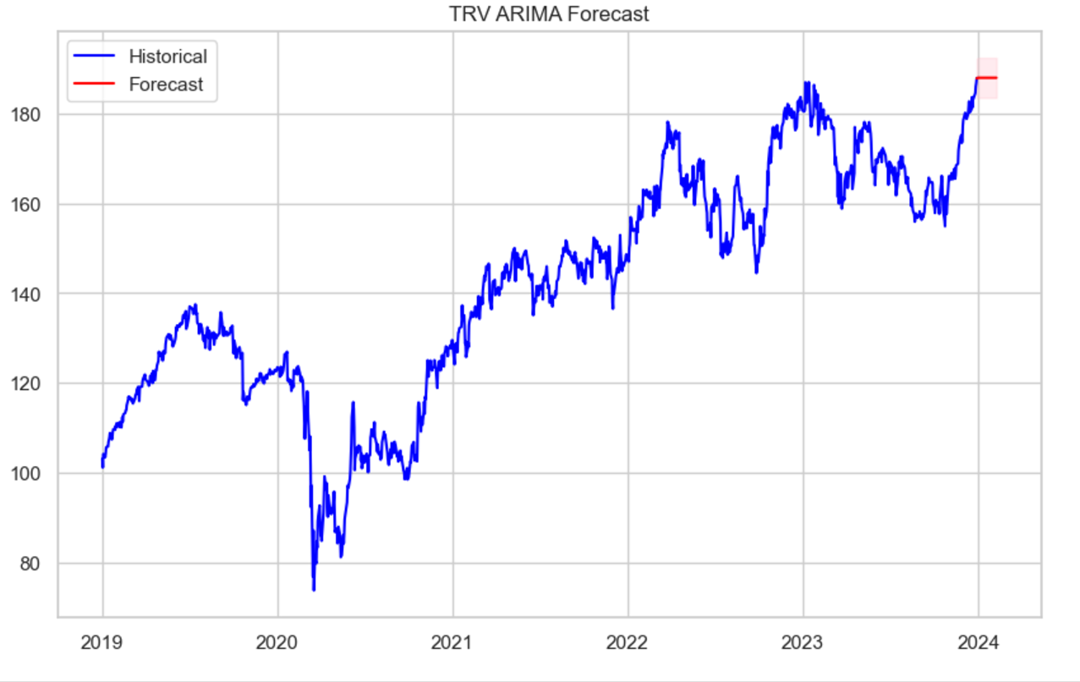
ARIMA Forecast:

Slide 27
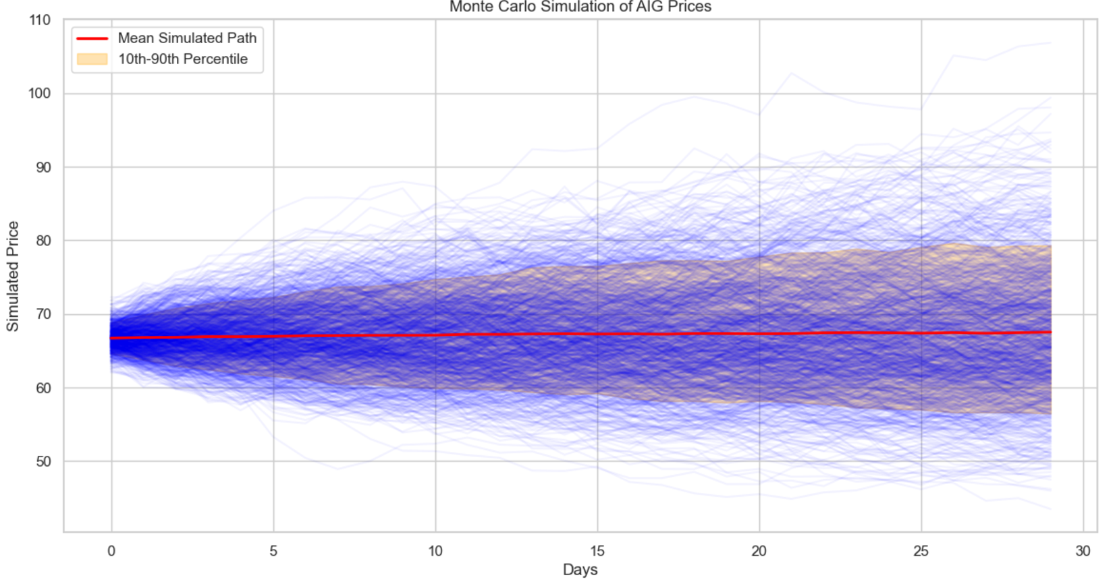
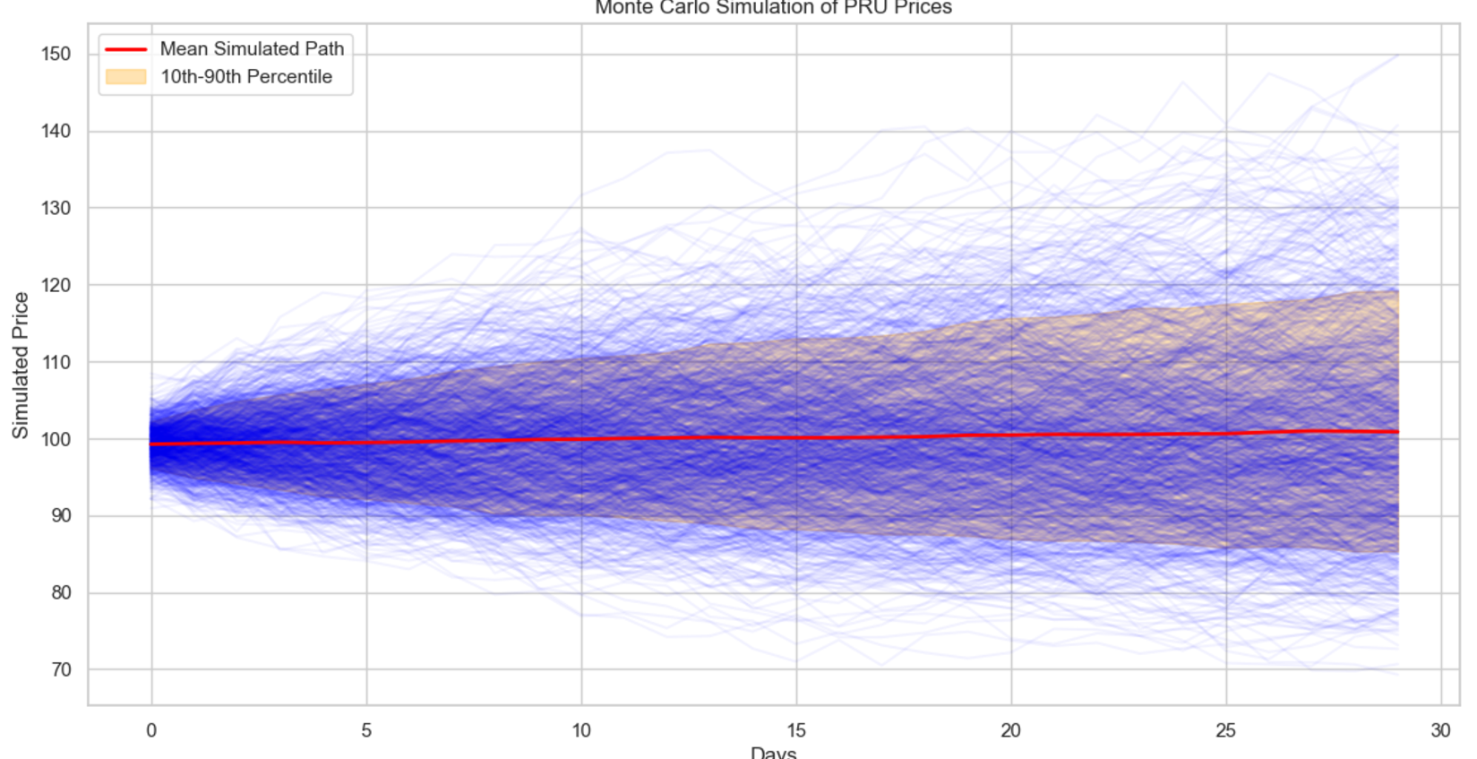
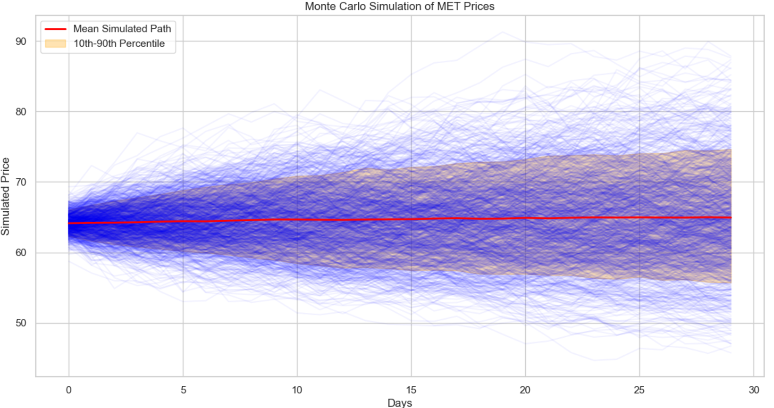
Monte Carlo Simulation:

Slide 28


Monte Carlo Simulation:

Slide 29

Portfolio Optimization:

Slide 30

Efficient Frontier:

Slide 31
Conclusion:
Volatility and Risk Analysis
AIG and MET exhibited higher volatility, making them suitable for aggressive investment strategies, while TRV displayed lower volatility, ideal for risk-averse investors.
Volatility spikes during 2020 highlighted significant market sensitivity to macroeconomic shocks.
Impact of Economic Trends
All stocks experienced recovery trends post-2020 crash, with TRV and ALL demonstrating resilience.
Long-term growth trajectories reflect alignment with industry benchmarks.
CAPM Analysis
AIG and MET are undervalued according to the SML, promising more than expected returns for their beta.
TRV and PRU show overvaluation or inefficiencies in the market and should be invested in with care.
Risk-Adjusted Returns
Sharpe and Treynor ratios confirm ALL as the most efficient in risk-adjusted performance.
High Sharpe ratios in AIG and MET indicate good returns in relation to their risks.
Portfolio Analysis Using Modern Portfolio Theory (MPT)
The efficient frontier analysis underlines the benefits of diversification by balancing high-beta stocks with stable performers.
Aggressive portfolio strategies are dominated by AIG and MET, while TRV and ALL provide the supporting defense.

Slide 32
Conclusion:
AIG and MET are promising stocks to deliver higher risk-adjusted returns and could be used by investors seeking growth-oriented portfolios.
TRV and ALL help balance portfolios due to lower volatility, hence offering stability during times of economic turmoil.
Rebalancing: Periodically review and rebalance such portfolios in line with changeable market dynamics, especially for stocks with high beta.
Correlation Management: Implement insights from correlation analysis to steer clear of overexposure to strongly correlated stocks to minimize systemic risk.
Market Hedging: Utilize TRV and ALL as defensive investments, in particular during market downturns, to protect portfolio value.

Slide 33
Thank You!!

